Slide 1
Project Burn Notice
Andrew Sender (asender@lgsinnovations.com)
July 14, 2017

Slide 2
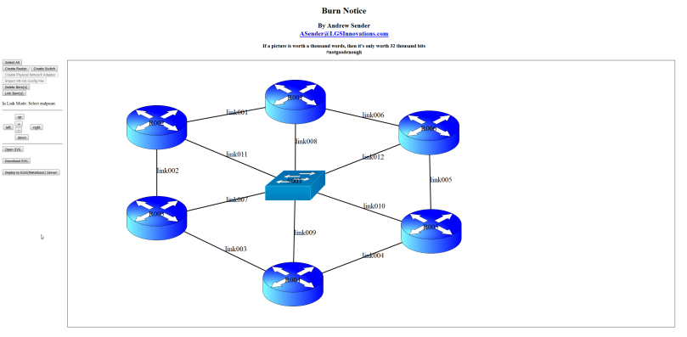
Burn Notice (Virtualization GUI Tool)
Overview | Objective Design & Deploy Virtualization through a WEB Framework Reduce Networking Errors Expedite Network Bring Ups Give a visual sense of the network being designed. And possibly deliver visual to customer Create and modify virtual switches & port groups with ease and simplicity Deploy virtual machines (ALU SR-OS requires a VM per card) with ease and simplicity Autonomously configure routers after VM boot up Make sure IP Address Schema is coherent
Approach Web Framework HTML5 (SVG) JavaScript Perl Server Side (May change to Python or Go if getting assistance) SSH into host (ESXI server for now, but can be expanded to frameworks like OpenStack) to deploy VMs and vSwitches by running commands like ‘esxcli’ and ‘ovftool’ | Business Impacts Improve Testing by Virtualization Optimize Cloud Setups Status Web Framework established Proof of concept works Need to experiment with SR-OS/SR-OS-MG to understand additional features: LAG, OSPF, ISIS, SGW, PGW

Slide 3
Concept
Design & Deploy Virtualization through a WEB Framework
Reduce Networking Errors
Expedite Network Bring Ups

Slide 4
User Perspective
Give a visual sense of the network being designed
And possibly deliver visual to customer
Create and modify virtual switches & port groups with ease and simplicity
Deploy virtual machines (ALU SR-OS requires a VM per card) with ease and simplicity
Autonomously configure routers after VM boot up
Make sure IP Address Schema is coherent

Slide 5
Framework
HTML5 (SVG): Not canvas because 1) Poor text rendering, 2) Poor event handling, 3) Resolution dependent
JavaScript
Perl Server Side (May change to Python or Go if getting assistance)

Slide 6
Competitors: GNS3 & VIRL
Both sandboxed to their own virtual platforms
Require download & installation per OS support
VIRL is $200/year by Cisco
GNS3 is open source ☺
Burn Notice approach is to script SSH sessions to various virtual servers (ESXi & OpenStack)

Slide 7
End of Presentation

